Slide 1
FUNCTIONS
Lecturer: Nadia Binte Asif

Slide 2
Intro
Group of Statements that together perform a task
Specific Task
Sub-routine, Method, Procedure etc.
void main( ) {
printf(“Let’s learn about functions\n”);
}

Slide 3
Types of Function
Built-in
Strcat(), memcpy(), printf(), scanf()
User Defined
Return type
Defines the type of returned value
Function Name
Parameter list
Type
Order
Values to be used inside function
Function Body
Returned Value
return_type function_name( parameter list ) {
body of the function
return value
}

Slide 4
Finding max
/* function returning the max between two numbers */
int max(int num1, int num2) {
/* local variable declaration */
int result;
if (num1 > num2)
result = num1;
else result = num2;
return result;
}

Slide 5
Finding sum of n integers

Slide 6
Declaration of a function
#include <stdio.h>
/* function declaration */
int max(int num1, int num2);
int main () {
/* local variable definition */
int a = 100; int b = 200; int ret;
/* calling a function to get max value */
ret = max(a, b);
printf( "Max value is : %d\n", ret );
return 0;
}
/* function returning the max between two numbers */ int max(int num1, int num2) {
/* local variable declaration */
int result;
if (num1 > num2)
result = num1;
else
result = num2;
return result; }

Slide 7
Call by value
This method copies the actual value of an argument into the formal parameter of the function.
In this case, changes made to the parameter inside the function have no effect on the argument.
#include <stdio.h>
void swap(int x, int y);
int main () {
int a = 100, int b = 200;
printf("Before swap, value of a : %d\n", a );
printf("Before swap, value of b : %d\n", b );
swap(a, b);
printf("After swap, value of a : %d\n", a );
printf("After swap, value of b : %d\n", b );
return 0;
}
/* function definition to swap the values */ void swap(int x, int y) {
int temp; temp = x;
x = y;
y = temp;
return;
}
OUTPUT:
Before swap, value of a : 100
Before swap, value of b : 200
After swap, value of a : 100
After swap, value of b : 200

Slide 8
Call by Reference
#include <stdio.h> int main () {
int a = 100, int b = 200;
printf("Before swap, value of a : %d\n", a );
printf("Before swap, value of b : %d\n", b );
swap(&a, &b);
printf("After swap, value of a : %d\n", a );
printf("After swap, value of b : %d\n", b );
return 0;
}
void swap(int *x, int *y) {
int temp;
temp = *x; /* save the value of x */
*x = *y; /* put y into x */
*y = temp; /* put temp into y */
return;
}
This method copies the address of an argument into the formal parameter.
Inside the function, the address is used to access the actual argument used in the call.
This means that changes made to the parameter affect the argument.
OUTPUT:
Before swap, value of a : 100
Before swap, value of b : 200
After swap, value of a : 200
After swap, value of b : 100

Slide 9
Types of Functions
int sum();
int sum(int x, int y);
void sum();
void sum(int x, int y)
Returns No Value.
Processing and Output→ Inside Function.
Calling function only makes the call
Returns Integer Value to the calling function
Calling function sends param
Processing done in Called Function
Returns Integer Value
Calling function sends no param
Processing → Inside Func
Called function must store returned value
Returns No Value.
Calling function sends param
Called function → Processing and Output

Slide 10
Problems
Write a Function to find prime number
Write a Function to find Fibonacci Series
Write a Function to check Factorial
Write a Function to find sum of n integers
Write a Function to find sum of first 10 odd integers.h

Slide 11
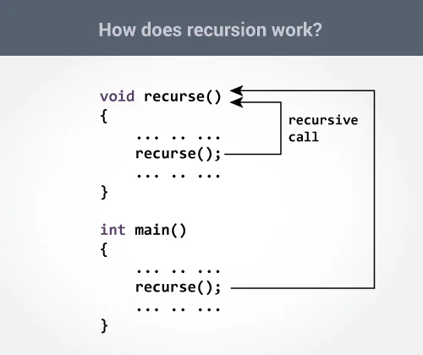
Recursion
A function that calls itself is known as a recursive function. And, this technique is known as recursion.
The recursion continues until some condition is met to prevent it

Slide 12
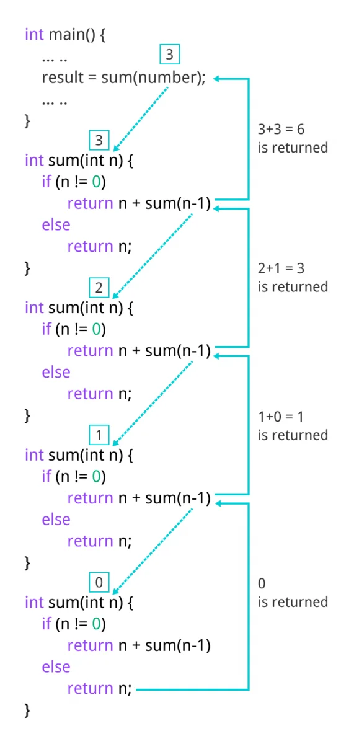
#include <stdio.h>
int sum(int n);
int main() {
int number, result;
printf("Enter a positive integer: ");
scanf("%d", &number); r
esult = sum(number);
printf("sum = %d", result);
return 0;
}
int sum(int n) { I
f (n != 0)
// sum() function calls itself
return n + sum(n-1);
else return
n;
}
OUTPUT:
Enter a positive integer:3
sum = 6

